Slide 1
Live Virtual Class 7
Spring Boot with Microservices Rahul Dixit

Slide 2
Agenda
In this Unit you will learn : -
Understand the fundamentals of microservices, including their architecture and the benefits they offer in developing scalable and modular applications.
Gain proficiency in creating a project structure suitable for microservices using Spring Boot.
Acquire practical knowledge of implementing microservices using Spring Boot, including building and deploying individual services, as well as managing their interactions and dependencies.
Develop an understanding of coding standards specific to microservices development.

Slide 3
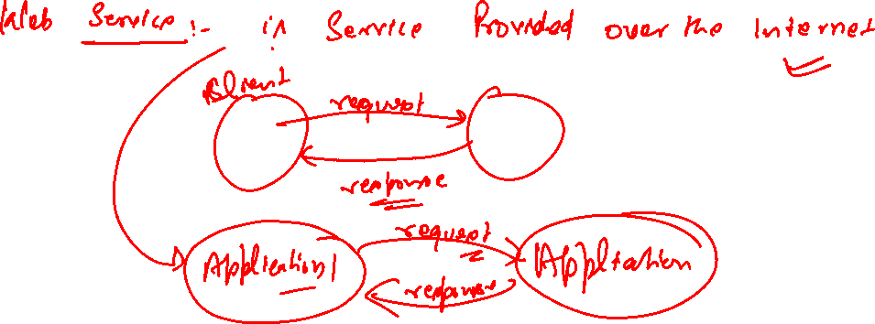
Learning Outcome:
Learn about Spring Boot Microservices

Slide 4
Web Services
Service which is delivered over the web
Output format which is consumed by other application.
Software system designed to support interoperable machine to machine interaction over the web.
Designed for machine to machine (application to application) interaction
Should be interoperable – Not platform dependent
Should allow communication over the network.

Slide 5
?
Q1 : How does data exchange between application takes place ?
Q2 : How can we make web service platform independent?
Request | Response object should be platform Independent.
Q3 : How does application know the format of Request and response ?
Service Definition :
Request | Response format (XML | Json)
Request Structure :
Response Structure :
End Point : url Exposed.

Slide 6
Introduction to Microservices
Microservices :-
architectural style that structures an application as a collection of small, loosely coupled, and independently deployable services.
Each microservice focuses on a specific business capability and operates as a separate entity that communicates with other services through well-defined APIs.
Microservices promote modularity, scalability, and flexibility in software development, allowing teams to work on different services independently, using different technologies and deployment strategies.

Slide 7
Microservices Architecture

Slide 8
Microservices architecture is an architectural style where an application is composed of multiple small, independent services that work together to fulfill business functionalities.
Here are some key aspects of microservices architecture:
Decentralized Data Management : each service has its own dedicated database or data store.
Service Independence and Autonomy : Each service is responsible for a specific business capability and operates independently of other services.
Scalability and Fault Tolerance : Microservices architecture enables horizontal scalability, where individual services can be scaled independently based on their specific demands. This allows efficient resource utilization and better handling of varying traffic patterns.

Slide 9
4. API Gateways and Service Discovery : an API gateway acts as a single entry point for clients to interact with the system. The API gateway handles requests from clients, performs necessary authentication, routing, and load balancing, and forwards the requests to the appropriate microservices.

Slide 10
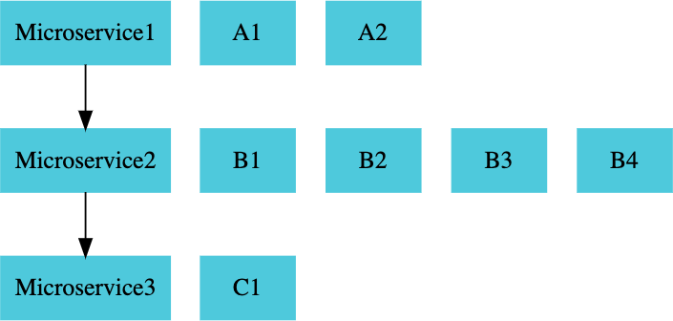

Slide 11
Challenges :
Bounded Context : Deciding the boundary is an Evolutionary process.
Configuration Management : There are many microservices with multiple instances . How is the Configuration Done?
Dynamic Scale Up and Scale Down : Load Balancing
Visibility : Need Monitoring | When service has an error | Which service is down | find bug | is Automated.
Pack of Cards : How we prevent if one service is down & rest services must be functional.

Slide 12
Microservices Solution
Spring Boot : Enables rapid development of rest api | Faster api development.
Spring Cloud : Umbrella project that provide essential microservice needs.
Docker : Consistent deployment approach for microservices. Programming language and environment independent.
Kubernetes : Orchestrate thousands of microservices with advanced features (Service discovery | Load balancing | Release Management,….)

Slide 13
Answer : Spring Cloud
Spring cloud : Spring Cloud provides tools for developers to quickly build some of the common patterns in distributed systems. e.g. :-
configuration management
service discovery
circuit breakers
intelligent routing etc
Variety of projects under the umbrella of spring cloud
Spring cloud Netflix : dealing in microservice concept very early.

Slide 14
Spring Cloud
Spring Cloud Umbrella Projects
Centralized Configuration Management (Spring Cloud Config Server) : manage configuration for multiple microservices in central git repository.
Location Transparency | Service Discovery - Naming Server (Eureka) : Enables automatic discovery of microservice.
Load Distribution (Ribbon, Spring Cloud Load Balancer): Distribute request across active instances of microservices dynamically.

Slide 15
Visibility and Monitoring (Zipkin) | Distributed Tracing : A single request can send to multiple microservice if there is a bug which microservice have this. Trace request along all microservice.
Edge Server | API Gateway (Zuul, Spring Cloud Gateway) : Single entry point Implement Common features like authentication .
Fault Tolerance (Hystrix, Resilience4j) : Ensure that failure of one microservice does not cascade and make other microservice fail.

Slide 16
Microservices - Advantages
Adapt New Technology & Process Adoption : Team can adopt new technologies and process for individual service.
Flexibility – Choose best framework and languages for each services.
Innovation – Easier to experiment and use emerging technologies.
Dynamic Scaling : Enable scaling of individual component based on demand.
Efficiency – Scale only the services that need it reducing costs.
Faster Release Cycles : Smaller independent services can be developed tested and deployed more quickly .
Agility – Allows more frequent updates and quicker response to market demands.

Slide 17
Need for Centralized Configuration :
Lot of configuration required handled by Spring Cloud Config Server :
Provide an approach where you can store all the configuration different environment of all the different microservices in just one place.
Hence it becomes easy to maintain.

Slide 18
Standard Port
Application | Port
Course Microservice | 8080, 8081, ...
Spring Cloud Config Server | 8888
Student Microservice | 8000, 8001, 8002, ..
Netflix Eureka Naming Server | 8761
API Gateway | 8765
Zipkin Distributed Tracing Server | 9411

Slide 19
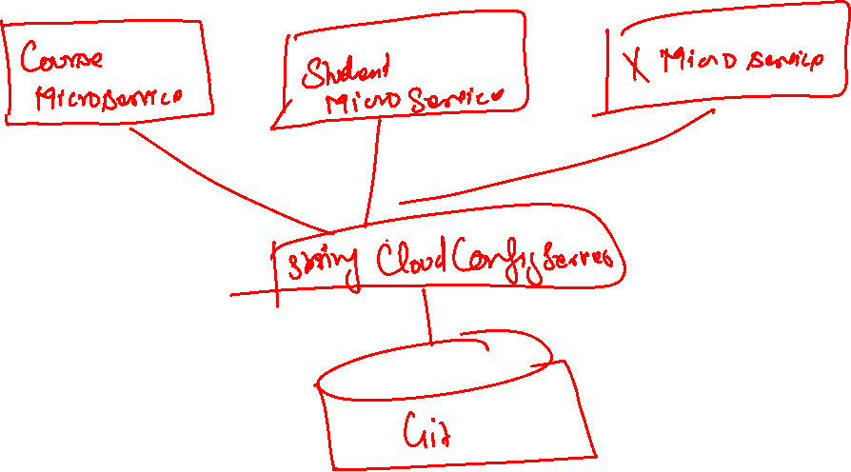
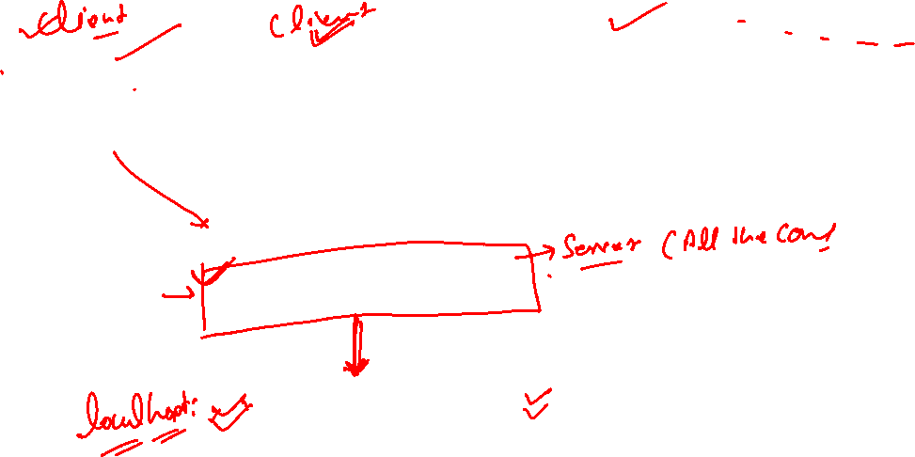

Slide 20
URL
Application | Url
Course Microservice | http://localhost:8080/courses
Spring Cloud Config Server | http://localhost:8888/courses-service/default http://localhost:8888/courses-service/qa http://localhost:8888/courses-service/dev
CurrenyExchange Microservice | http://localhost:8000/mentor-service/{mname}/
CurrencyConversion | 8100
Netflix Eureka Naming Server | 8761
API Gateway | 8765
Zipkin Distributed Tracing Server | 9411

Slide 21


















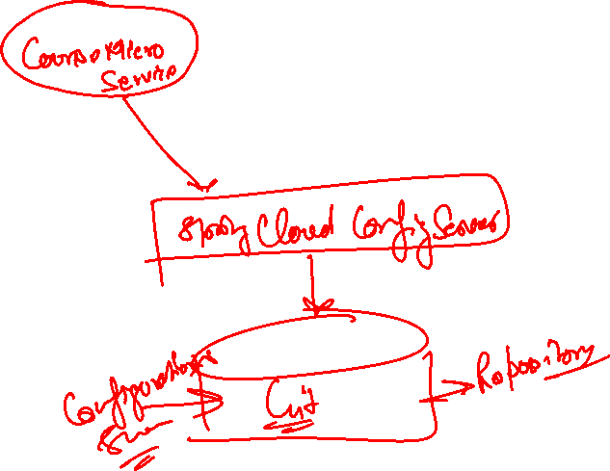










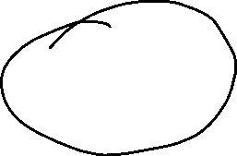
CourseMicroService and Create Config Server
Depedencies
Spring web
Devtools
Actuator
ConfigClient

Slide 22
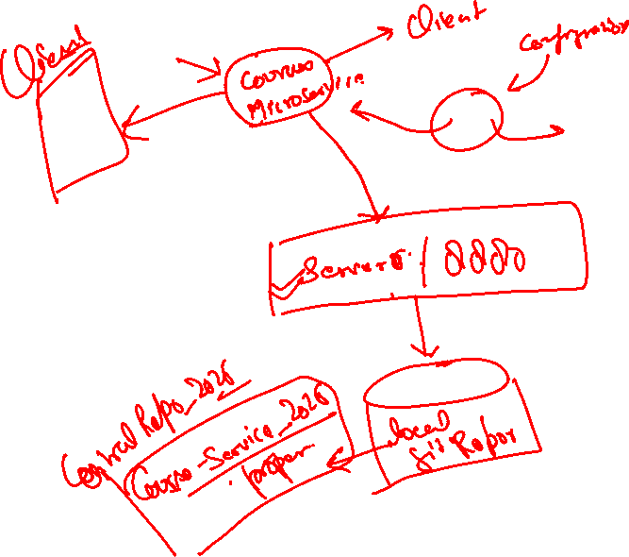
Create Course
Model Course
{
"id":10001,
“name":“Java",
“mentor":“Rahul",
}

Slide 23

CreateConfiguration
Fetch data from application properties
{
"id":10001,
“name":“Java",
“mentor":“Rahul",
}

Slide 24
course-service
url : http://localhost:8080/course-service/{id}
url : http://localhost:8080/course-service/courses
{
"id":10001,
“name":“Java",
“mentor":“Rahul",
"environment":"8000 instance-id"
}

Slide 25
mentor-service
url : http://localhost:8000/mentor-service/{mname}
{
"id":10001,
“name":“Rahul",
“numberOfCourses":“5",
“List":“[{}{}{}]",
"environment":"8080 instance-id"
}

Slide 26
Check if you have the right repository url in
/src/main/resources/application.properties
- spring.cloud.config.server.git.uri=file:///C:/path/microrepo
Do not have any spaces in your git repository path.
If you are on windows, make sure that you are using one of these formats for your git repository
file:///C:/microservices/git-localconfig-repo
file:\\C:/WORKSPACE/GIT/git-localconfig-repo
file:///C:/Users/Gautham/Documents/workspace-sts-3.9.4.RELEASE/git-localconfig-repo
file:\\C:/Users/Gautham/Documents/workspace-sts-3.9.4.RELEASE/git-localconfig-repo
Make sure that you have committed all the code to GIT Local Repo

Slide 27

5 min break
This a 5 min break for you
Have a glass of water
Take a deep breath
Note down any doubt you have till now
Join back
DO NOT WRITE ANYTHING
HERE. LEAVE THIS SPACE FOR
WEBCAM

Slide 28
Any doubts?

Slide 29
Spring Boot with Microservices

Slide 30
5 min break
This a 5 min break for you
Have a glass of water
Take a deep breath
Note down any doubt you have till now
Join back
DO NOT WRITE ANYTHING
HERE. LEAVE THIS SPACE FOR
WEBCAM

Slide 31
Summary
Point 1
Point 2
Point 3
DO NOT WRITE ANYTHING
HERE. LEAVE THIS SPACE FOR
WEBCAM

